Slide 1

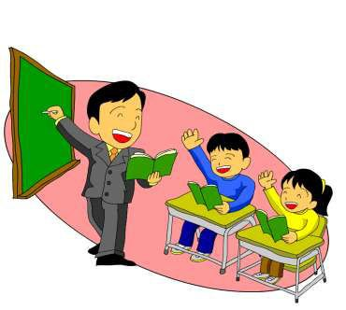
SIMPLE PRESENT TENSE

Slide 2

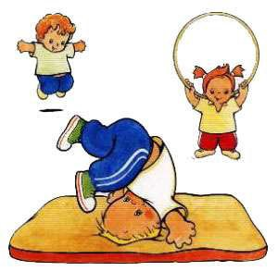
WHAT IS SIMPLE
PRESENT TENSE?
◆ The simple present tense in English is used to describe an action that is regular, true or normal.

Slide 3

STRUCTURE
In general, in the third person we add 'S'.
Subject |  |  | Verb | The Rest of the sentence
I / you / | we / | they | speak / learn | English at home
he / she | / it |  | speaks / learns | English at home

Slide 4
◆ The spelling for the verb in the third person differs depending on the ending of that verb:
1. For verbs that end in -O, -CH, -
SH, -SS, -X, or -Z we add - ES in the third person.
◆ go – goes
◆ catch – catches
◆ wash – washes
◆ kiss – kisses
◆ fix – fixes
◆ buzz – buzzes

Slide 5
2. For verbs that end in a consonant + Y,
we remove the Y and add -IES.
◆ marry – marries
◆ study – studies
◆ carry – carries
◆ worry – worries
NOTE: For verbs that end in a vowel + Y,
we just add -S.
◆ play – plays
◆ enjoy – enjoys
◆ say – says

Slide 6

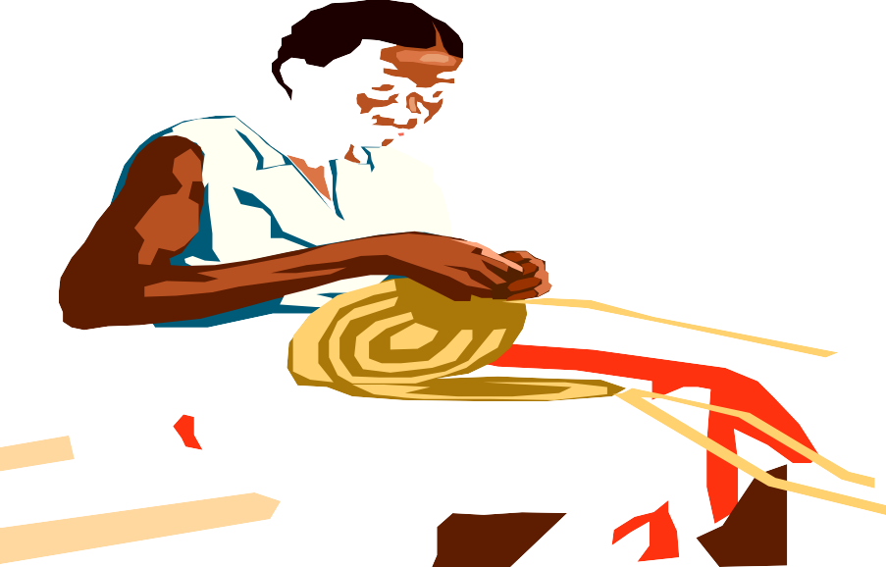
THE PRESENT SIMPLE TENSE
(Affirmative)
She works on her basket after dinner every day.

Slide 7
THE PRESENT SIMPLE TENSE
AFFIRMATIVE: WORK
I YOU | WORK
SHE HE IT | WORKS
WE YOU THEY | WORK

Slide 8




THE PRESENT SIMPLE TENSE
(Interrogative)
DOES HE WORK AS A DOCTOR?
YES, HE DOES

Slide 9
THE PRESENT SIMPLE TENSE
INTERROGATIVE: WORK
DO | I YOU | WORK?
DOES | SHE HE IT | WORK?
DO | WE YOU THEY | WORK?

Slide 10

THE PRESENT SIMPLE TENSE
(Negative)
HE DOESN’T WORK AS A DOCTOR.

Slide 11
THE PRESENT SIMPLE TENSE
NEGATIVE: WORK
I YOU | DO NOT DON’T | WORK
SHE HE IT | DOES NOT DOESN’T | WORK
WE YOU THEY | DO NOT DON’T | WORK

Slide 12
Practice
PRACTICE

Slide 13
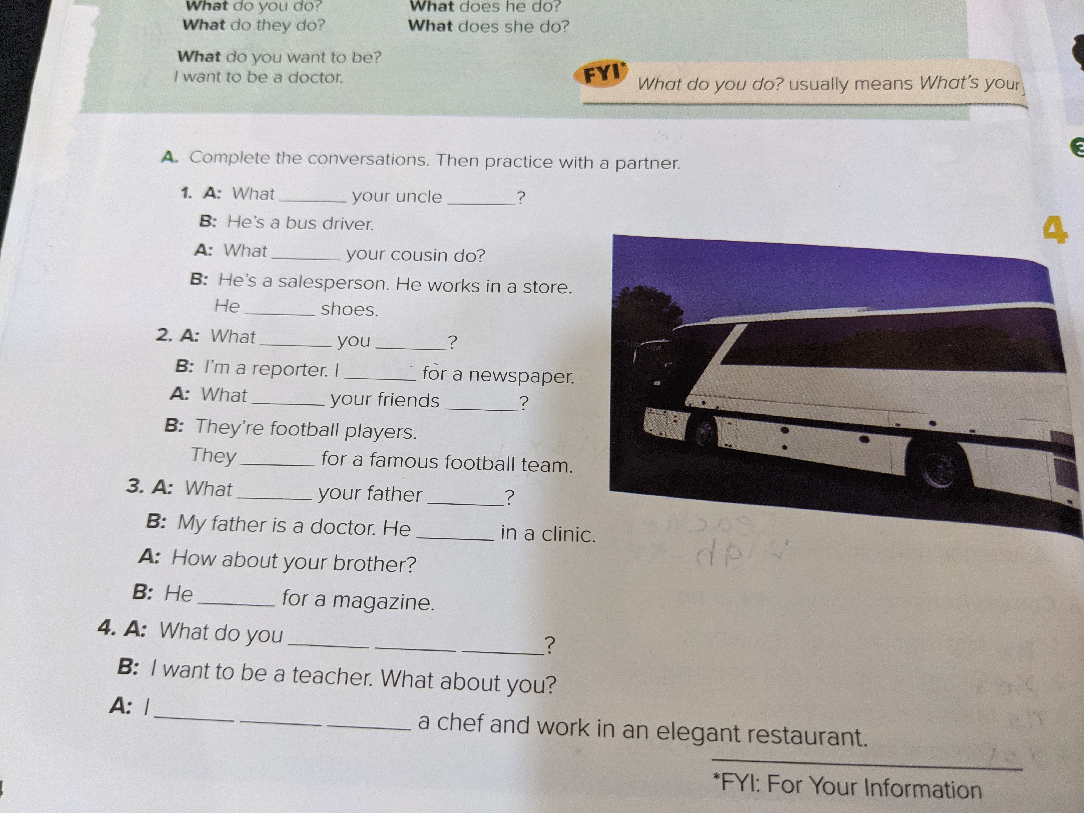

Slide 14
Practice 1
Complete the conversation. Then practice with a partner.
1.A:What......does......your uncle …......do......?
B: He's a bus driver.
A: What....does.......your cousin do?
B: He's a salesperson. He works in a store.
He.....sells.........shoes.
2.A: What.....do......you......do......?
B: I'm a reporter. I.......write........for a newspaper.
A: What......do......your friends..do.........?
B: They're football players.
They.......play.........for a famous football team.
3.A: What....does........your father …...do....?
B: My father is a doctor. He.....works.......in a clinic.
A: How about your brother?
B: He.........works..........for a magazine.
4.A: What do you.......want....... ….to.......... …be.........?
B: I want to be a teacher. What about you?
A: I ….want..... …...to.... …be..........a chef and work in an elegant restaurant.

Slide 15



